Slide 1
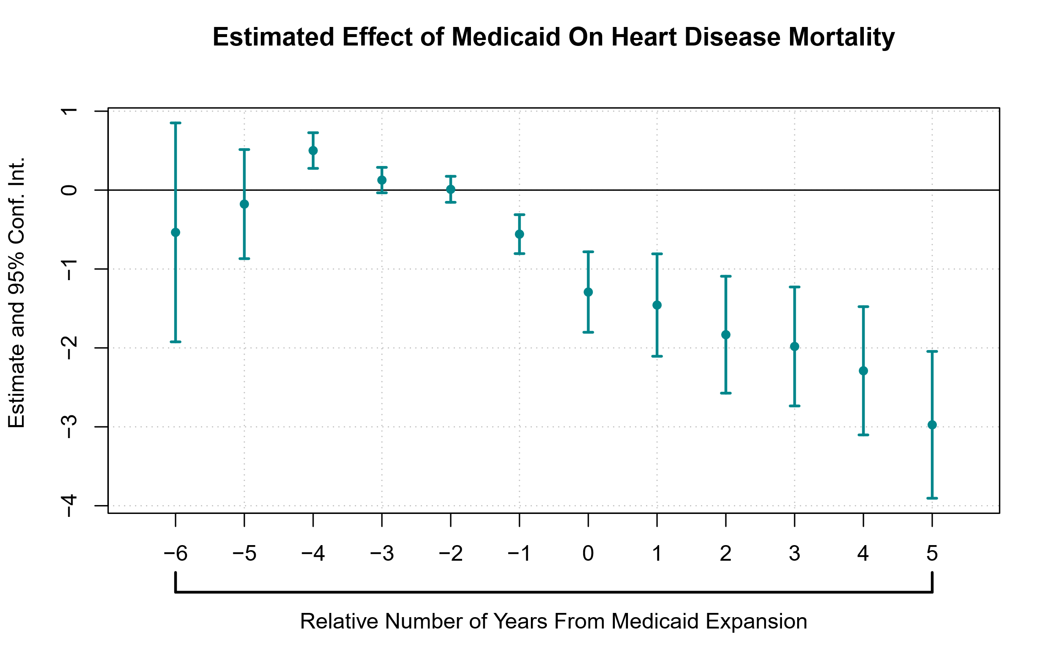
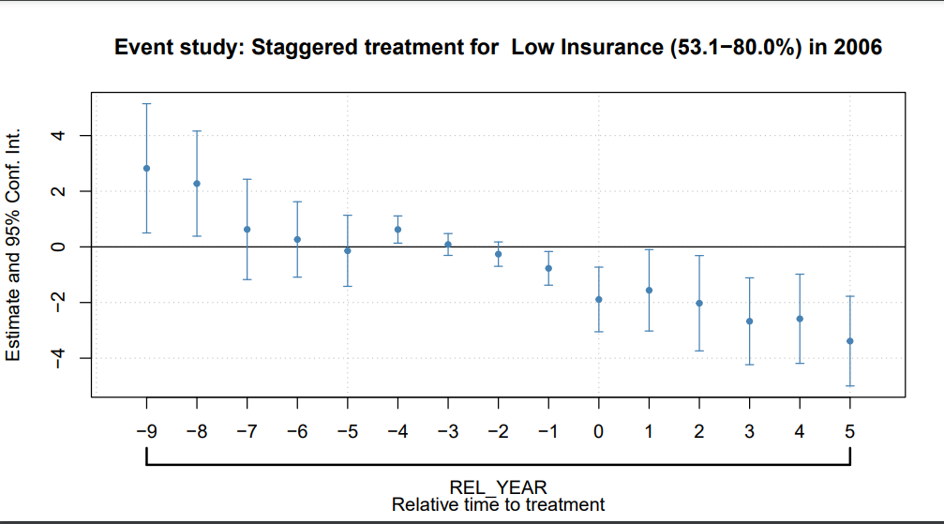
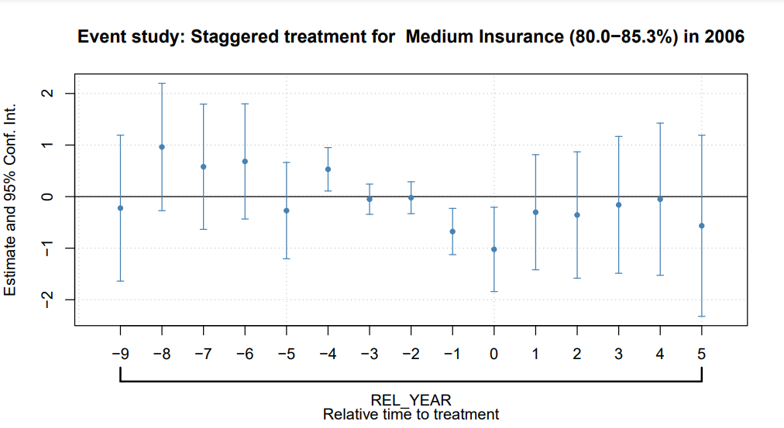
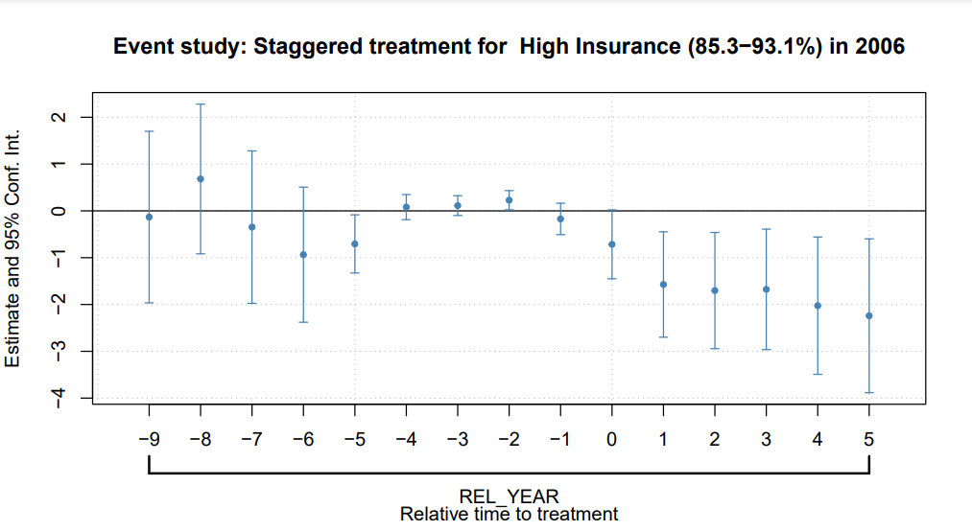


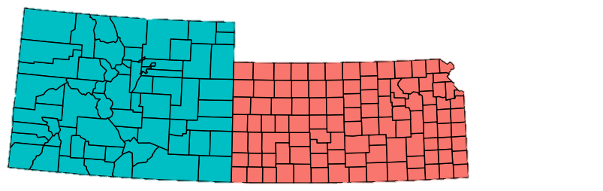
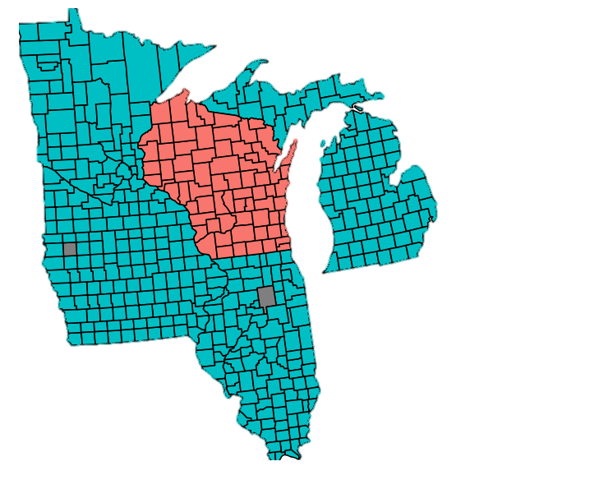
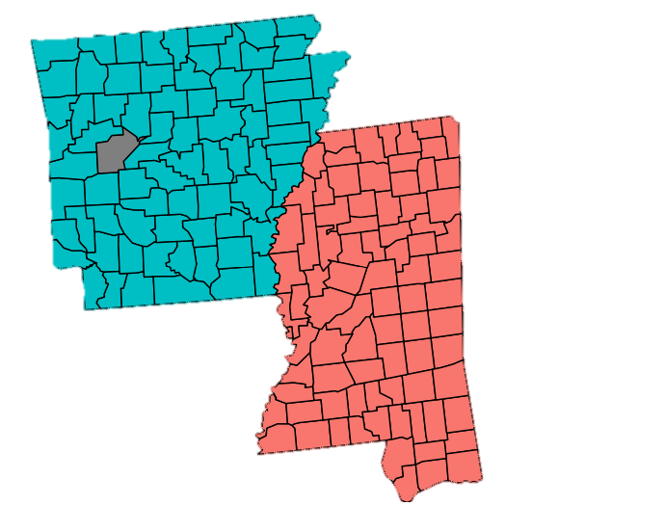
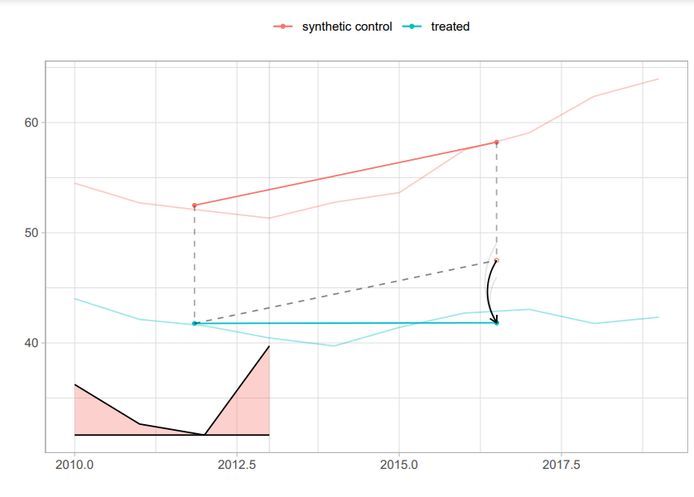
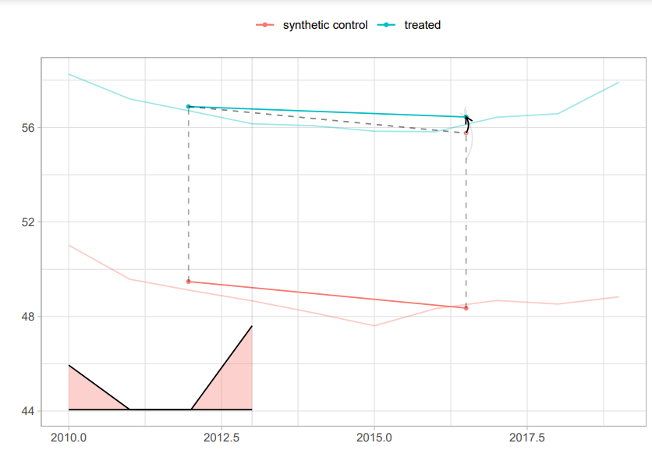
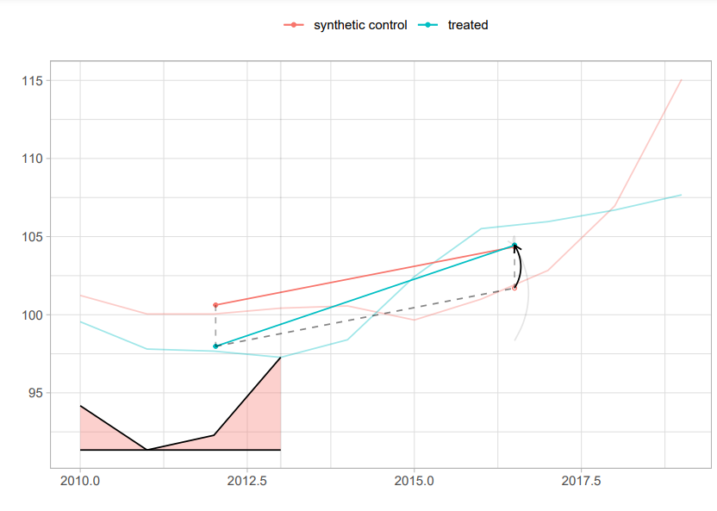
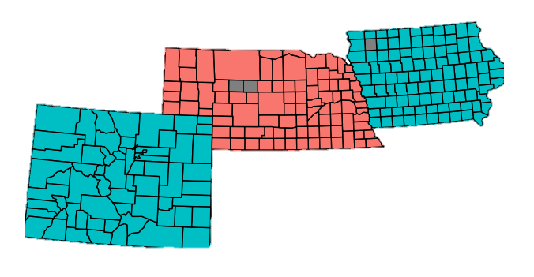
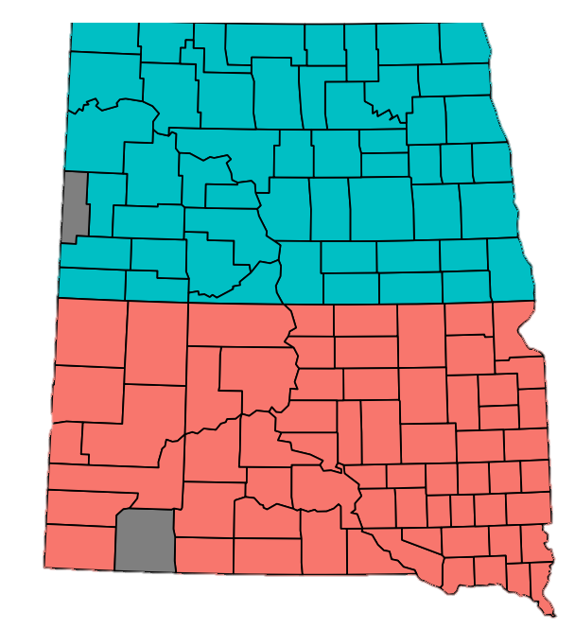
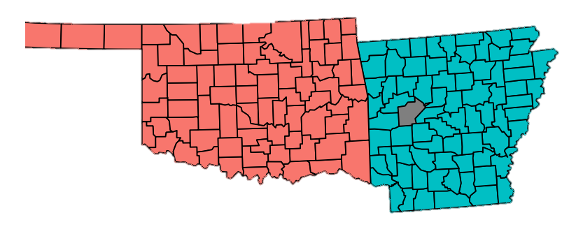
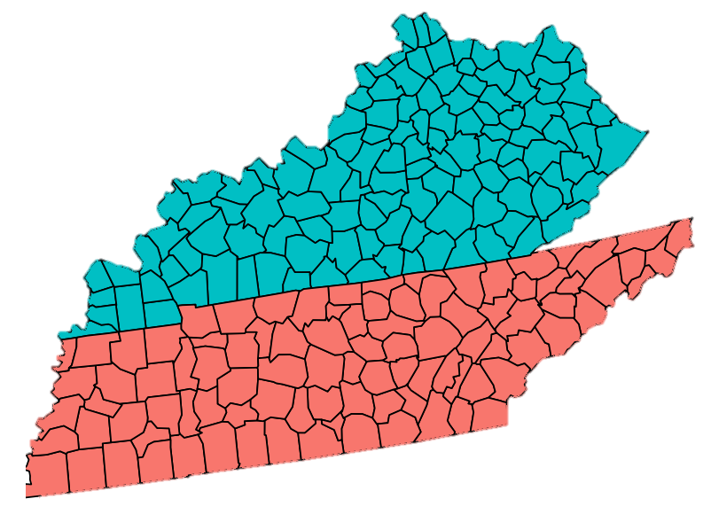
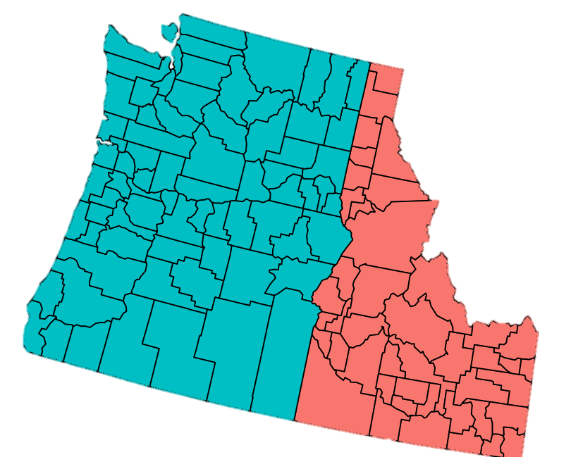
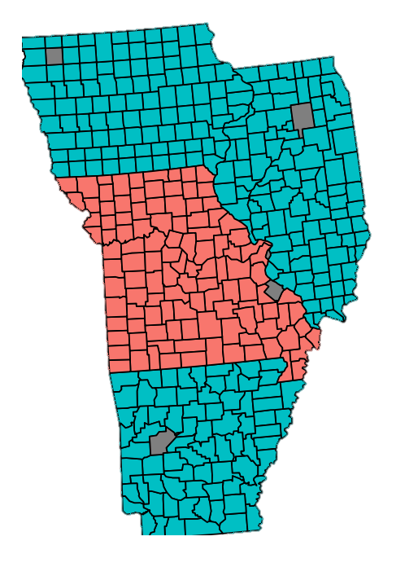
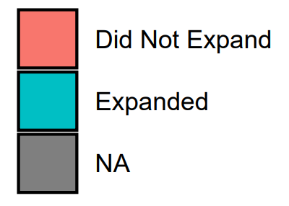
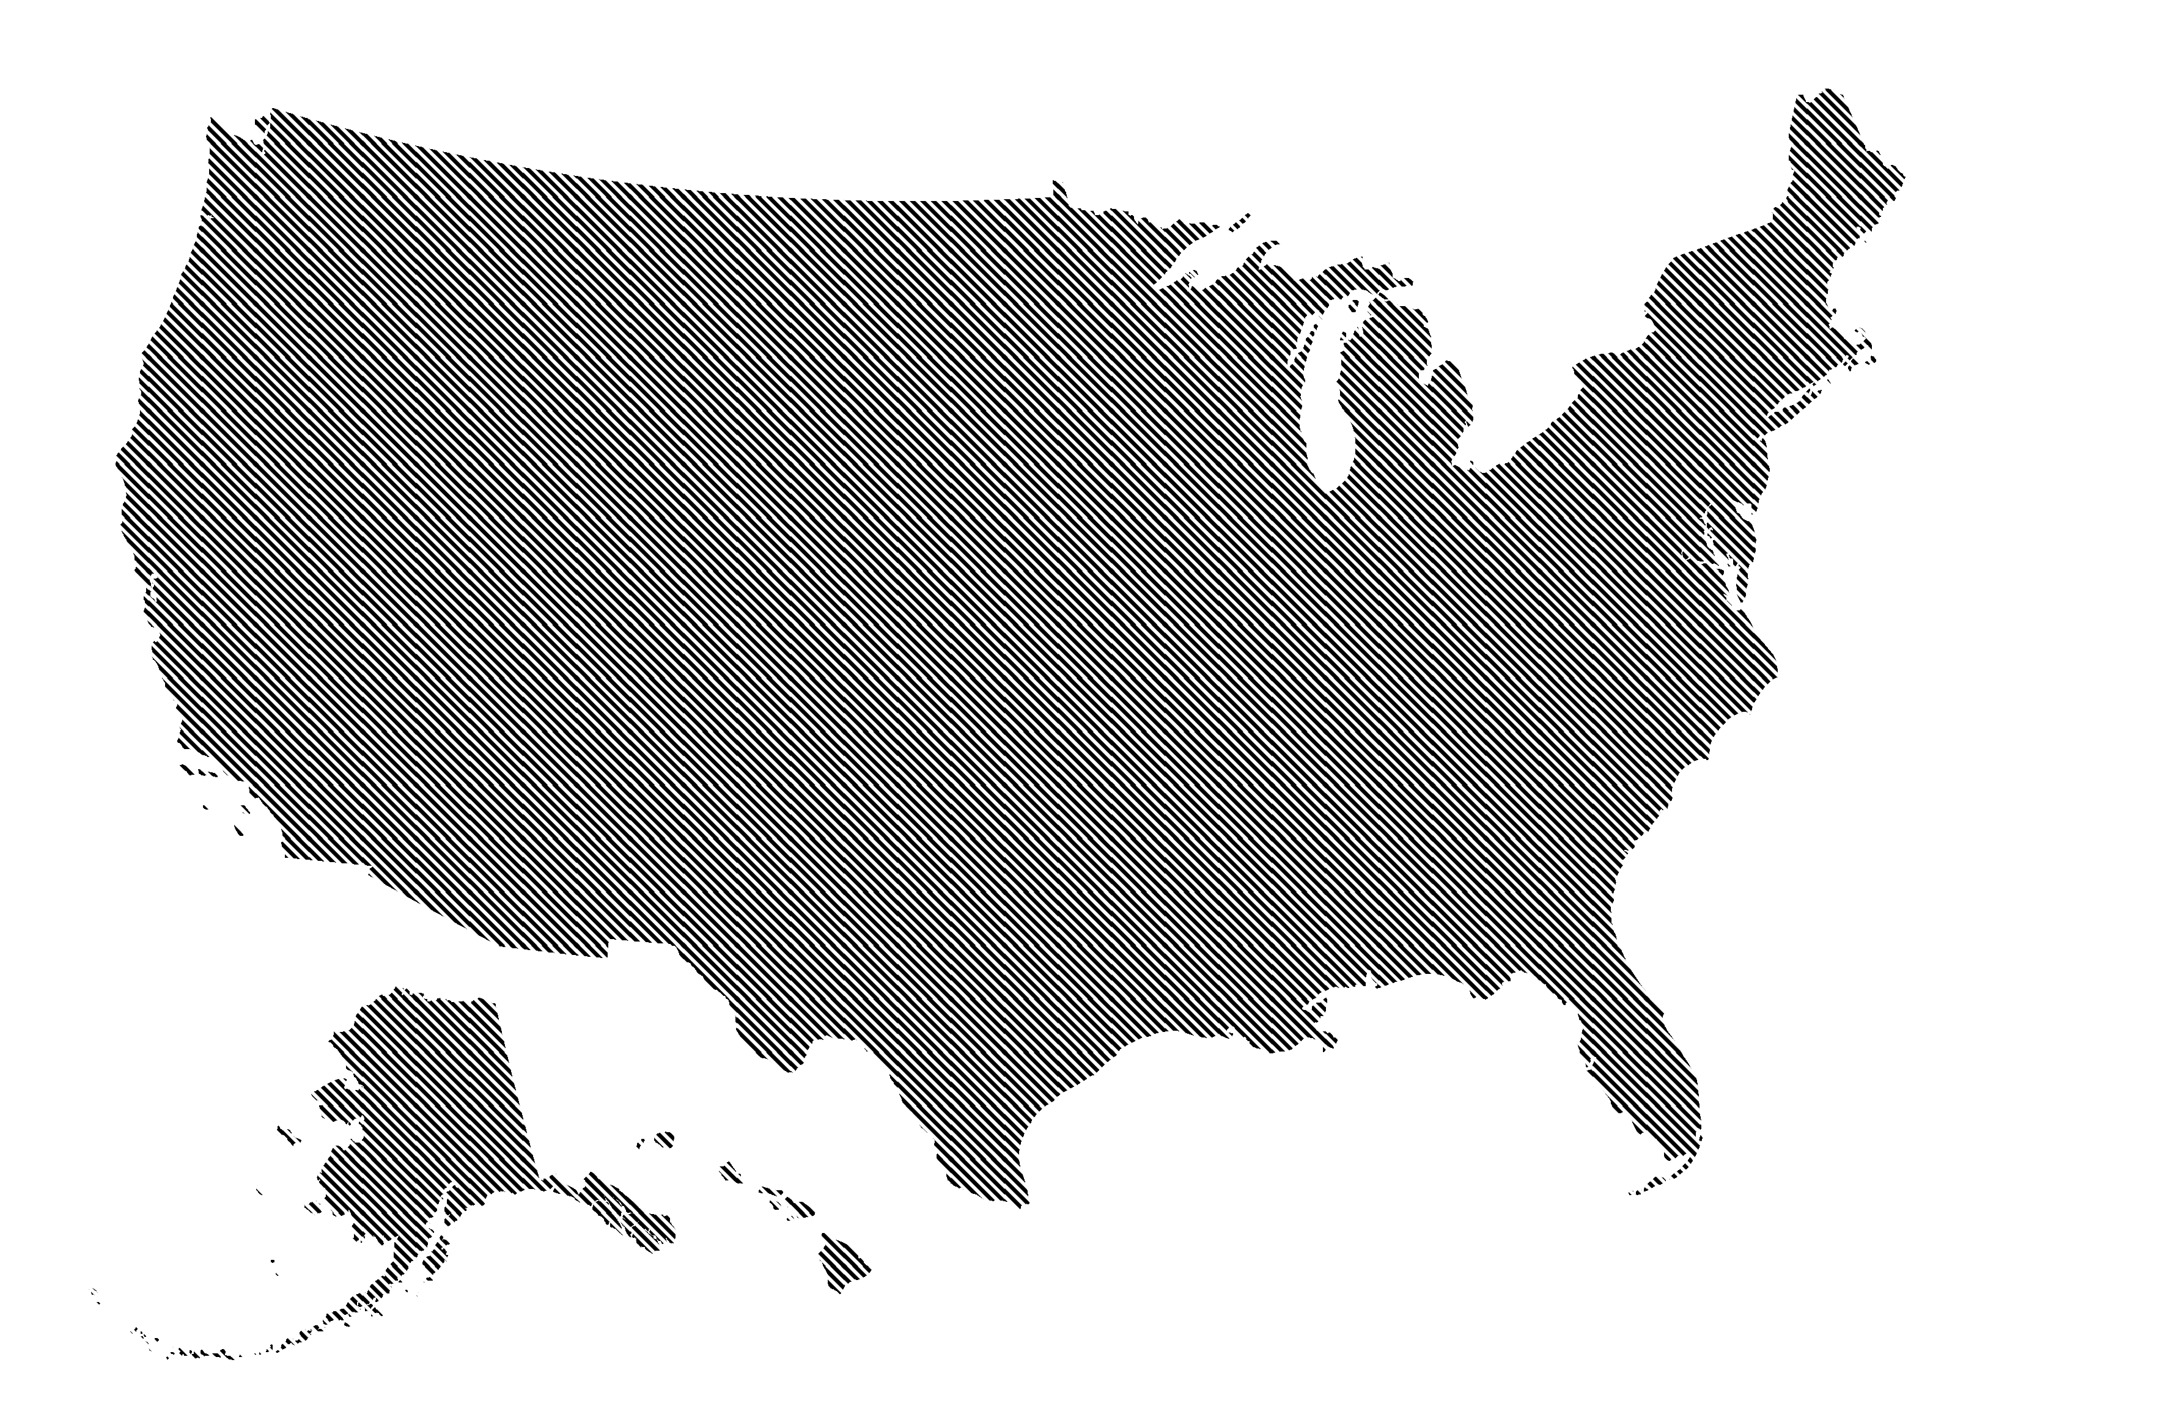
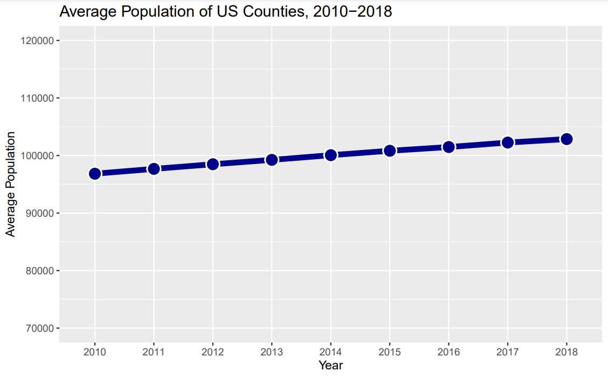
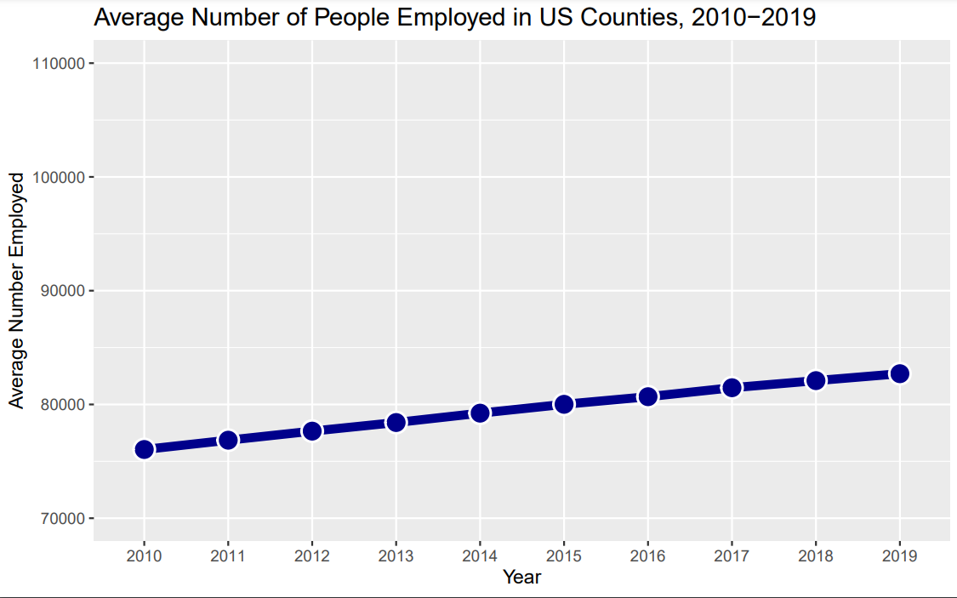
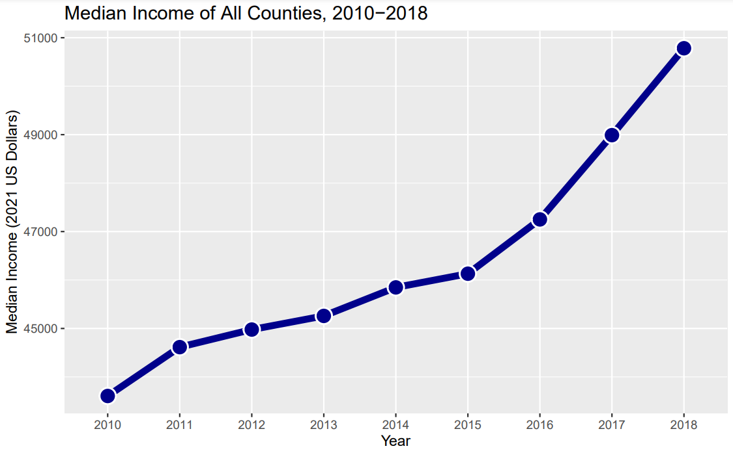
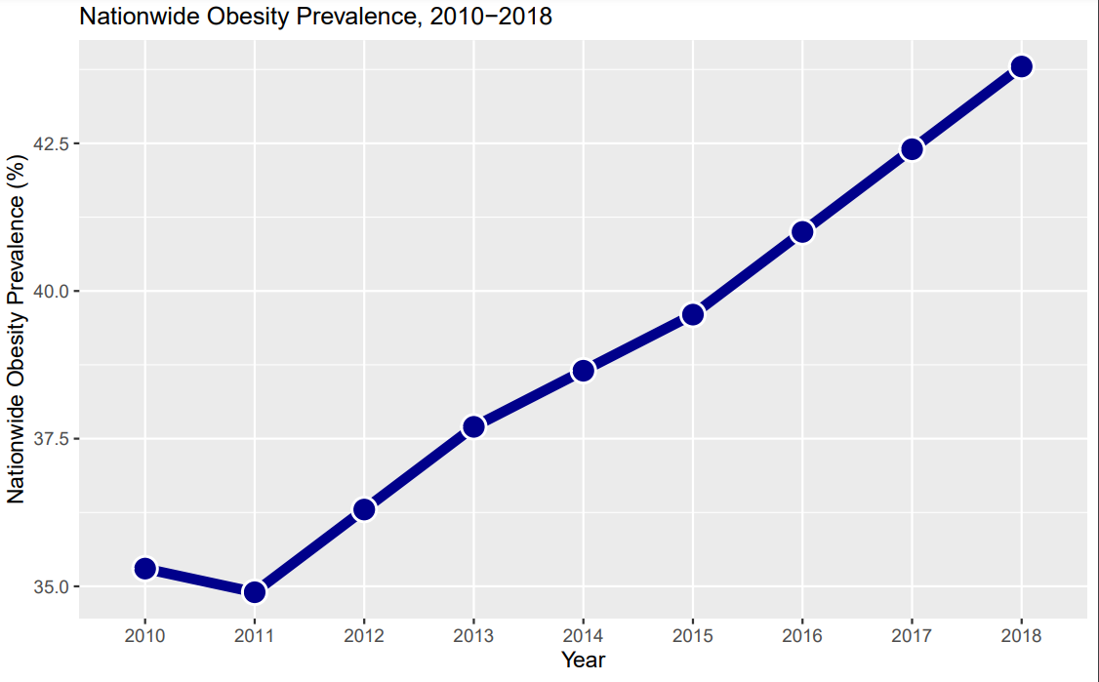
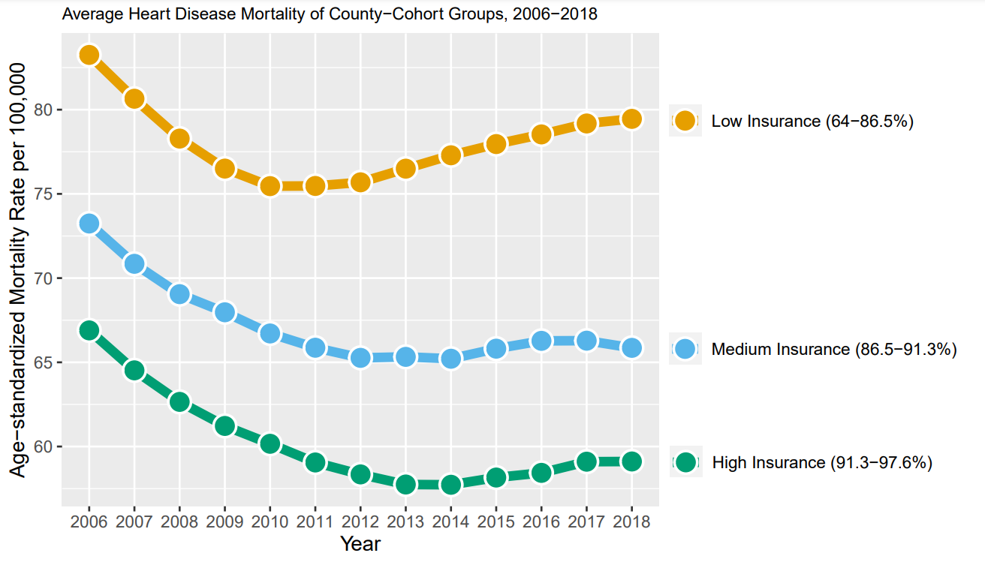

Impact of the Affordable Care Act on Heart Disease Mortality in the United States
Grady King and Srinivas Palanki
Department of Chemical and Biomedical Engineering West Virginia University, Morgantown, West Virginia 26505, USA
Introduction
Results
The Affordable Care Act (ACA) and the Medicaid expansions since 2014 have increased health insurance coverage in the United States by over 35 million people. However, little analysis has been done on the impact of this policy change on individual chronic conditions. Critically, a Supreme Court case in 2012 (National Federation of Independent Business v. Sebelius) ruled that the federal government’s punishment for withdrawing from Medicaid expansions wasn’t constitutionally sound, meaning individual states can choose to not participate in the Medicaid expansions.
National Causal Effect Analysis
In our nationwide analysis, we found a significant reduction in preventable heart disease mortality in counties that expanded Medicaid versus counties that did not. Additionally, we found the largest decrease in counties that had low insurance rates, and the second highest decrease in counties with high insurance rates.
Nineteen states either expanded after 2018, or still have not expanded, as shown in Figure 1. Using county-level data from over 3000 counties, we investigated the impact of the Medicaid expansions on preventable cardiac deaths, comparing states that underwent Medicaid expansion and states that did not using a two-stage difference-in-difference regression model.
Figure 1: Medicaid Expansion Status of US States
Low Insurance
Medium Insurance
High Insurance
Methodology
Our national causal effect analysis primarily revolves around a staggered two-stage difference-in-difference regression to isolate the effect of the Medicaid expansions. The regression is based on this equation:
y_{cgt} = µ_{g} + η_{t} + τ_{gt} D_{gt} + ε_{cgt}
Data Collection
Adjacent Cohorts Analysis
y_{cgt} | heart disease mortality: c denotes each county t denotes time g denotes group membership
µ_{g} | time-invariant group characteristics
η_{t} | time-based shocks experienced by all counties
τ_{gt} | group-time average treatment effect, the effect of the treatment
D_{gt} | indicator for whether initial-treatment group g is receiving treatment in period t
ε_{cgt} | error variable
Expansion Status, Heart Disease, Insurance Coverage
Covariates:
Population, Employment, Obesity, Income
In this analysis, we compare small groups of states in similar regions in order to better control for confounding variables. We used the synthetic differences-in-differences estimator, as it is more robust in scenarios with fewer counties. We found a heterogeneous outcome, with some comparisons showing a decrease in mortality, some showing a neutral effect, and some showing an increased mortality rate.
Preliminary Analysis
Mapping Heart Disease & Insurance
Comparison by Grouping
Social Factor Comparisons
Example Analysis
Decreased Mortality
Neutral Effect
Increased Mortality
The two-stage DID model modifies this by:
1) Estimating the model
y_{cgt} = µ_{g} + η_{t} + ε_{cgt}
using the counties that never expand Medicaid in order to estimate the group and time effects to create “adjusted outcomes”: ỹ_{cgt} = y_{cgt} - µ_{g} - η_{t}
2) Regressing adjusted outcomes ỹ_{cgt} on treatment status D^{k}_{gt} to estimate treatment effects τ^{k}, where k is each year.
This is used to avoid the TWFE model. TWFE typically results in several simple 2x2 DiD comparisons, some of which compare later-treated groups with already-treated groups as the control, which can create strange estimations when the treatment outcome has longitudinal changes.
National Causal Effect Analysis
Two-stage Difference-in-Difference Regression
Two-stage DID Grouped by Initial Insurance Coverage
Adjacent Cohorts Analysis
Preliminary Analysis: Plots & Maps
Regional Causal Effect Analysis
w/ Synthetic Difference-in-Difference
Preliminary Analysis
Additional analysis groups
Our preliminary analysis found high variance in heart disease mortality and insurance coverage changes between counties, as shown by Figures 2 and 3, making a simple analysis difficult. Similarly, the covariates in figure 4 both vary over time and vary between counties as well. This led us to causal inference analysis, which can extract the treatment effect given longitudinal data. We found a large disparity in heart disease mortality when grouping by low, medium, and high insurance coverage in 2006, which we continued into our national causal effect analysis. Additional analysis found similarly large disparities in counties when grouped by certain social factors, most of which are accounted for in our covariates.
Discussion & Conclusions
Figure 2: % Change in Heart Disease Mortality, 2010 to 2018
Figure 4: Covariates from 2010-2018
Our national causal effect analysis found a significant decrease of preventable heart disease mortality due to the Medicaid expansions after 5 years. (-2.975, 95% Conf: [-2.044, -3.905]) A nationwide reduction in heart disease mortality of this scale would prevent 14,613 deaths over 10 years. Our adjacent cohorts analysis sparks leads towards future research to find what causes the variances in the effect of the Medicaid expansion in these smaller cohorts.
There are some limitations to our methodology. Using data for mortality aggregated to the county-level means that individual-level factors that actually determine eligibility, such as income, parental status, employment status and pregnancy status cannot be adequately accounted for in the analysis. Another limitation is from having to use nationwide obesity data per year, rather than county-level data, which is not available on a consistent basis. Additionally, as mentioned in Garthwaite et al. 2019, provisions of the Affordable Care Act other than the Medicaid expansion may influence mortality as well. The ‘ACA marketplace’ provides subsidies for private insurance for some individuals, and the ‘welcome mat effect’ both have the potential to increase insurance coverage without any Medicaid expansion, which may have an effect on the regression.
Future analysis investigating the Affordable Care Act’s effect on other chronic diseases, such as kidney disease, cancer, lung disease, and hypertension could lead to additional insights into the effect of public insurance policy on disease. Additional analysis investigating policy differences in state-level implementation of Medicaid and differences in public insurance coverage before the Medicaid expansions may lead to conclusions investigating how a change in the income eligibility requirements changes chronic disease mortality levels, which would be more useful for policymakers. Additionally, a power analysis similar to proposed in Black et al. 2019 in order to address power concerns with this scale of analysis.
Average Population of US Counties, 2010-2018
Average Number of People Employed in US Counties, 2010-2018
Median Income of US Counties, 2010-2018
Nationwide Obesity Prevalence, 2010-2018
Figure 3: % Change in Health Insurance Coverage, 2010 to 2018
Figure 5: Average Heart Disease Mortality, Split by Insurance Levels, 2006-2018
Acknowledgements
Citations
Kyle Butts for assistance with DID methodologies
Wren King for supporting me throughout the project and suggesting some methodology additions
Papers/Figures:
Garthwaite, C., Graves, J., Gross, T., Karaca, Z., Marone, V., & Notowidigdo, M. (2019). All Medicaid expansions are not created equal: The geography and targeting of the Affordable Care Act. Brookings Papers on Economic Activity, 2019(2), 1-92.
Palanki, R., Chamarthy, S., & Palanki, S. (2021). Impact of the Affordable Care Act on diabetes diagnoses in the United States: A county-level analysis. Economic Affairs, 41(1), 111–122.
Black, B., Hollingsworth, A., Nunes, L., & Simon, K. (2019). Simulated power analyses for observational studies: An application to the Affordable Care Act Medicaid expansion. Journal of Public Economics, 213.
KFF. (2023, July 3). Status of State Medicaid Expansion Decisions: Interactive Map. https://www.kff.org/medicaid/issue- brief/status-of-state-medicaid-expansion-decisions-interactive-map/
R packages:
Di Lorenzo P (2023). _usmap: US Maps Including Alaska and Hawaii_. R package version 0.6.2.
R Core Team (2023). R: A language and environment for statistical computing. R Foundation for Statistical Computing,
Vienna, Austria.
Butts, Kyle (2021). did2s: Two-Stage Difference-in-Differences Following Gardner (2021). R package version 1.0.2.
Arkhangelsky D (2023). _synthdid: Synthetic Difference-in-Difference Estimation_. R package version 0.0.9.
Note: Figure 1 is a modified version of the KFF’s status of State Medicaid Expansion Decisions, and does not reflect the figure on KFF’s website

